Slide 1


Masters Preparations
Top View
- April, 2019-
Turning Point Program-
Logistics & Preparations
Master, L.4
Top View Program

Slide 2

Logistics
Logistics Session
Introduction to TPP Logistics (5 min.)
How to prepare for Turning Point Program?
Before
During
After
Questions (30 min.)
Closure (10 min.)

Slide 3
Introduction to TPP Logistics
Why does the logistics & preparations are so important for us?
In POY, the logistics supports the emotional process of our participants.
We are looking at the big picture and we are into the smallest details
The important ‘Unexpected but Precise’ value appears also through the logistics

Slide 4
About this guide
- Red -
Preparation
Everything you will need to prepare
for the workshop
1. Pre Turning Point Program- An online meeting with the team
2. Before Turning Point Program starts- 3 days
3. During Turning Point Program – 5 days
4. After Turning Point Program – 1 day

Slide 5

Facilitation
Orientation in the Agenda
Day 2
12:30-12:45 Our tools Led by a 3rd time Helper 12:45-13:30 Our D.N.A. Led by the lead Facilitator
Day 3
17:30 - 18:00 Our method Led by the lead Facilitator

Slide 6
Online Meeting
1. Pre Turning Point Program- An online meeting with the team
Meeting Agenda:
Facilitator’s & Helper’s: Arrival to return
Payments: allowance pee, invoices
Logistics: about the location, facilities, rooms etc.
Participants: how to prepare towards your group
Facilitation: Who is doing What?
Translation: yes/no

Slide 7
Online Meeting
1. Pre Turning Point Program- An online meeting with the team
Meeting Materials:
“Mothership file”- will be sent prior to the meeting
Facilitation | Final logistics | Personal Profiles
Facilitation table- Who is doing What? | Shipping list - TPP Materials | Full participant’s list
Team’s Agenda | Participant’s Room List | Participant’s profile X number of participants
Team's Sensitivity - Respect | Equipment left in the hotel | Bus list
Welcome opening (from TCP Nov 18)

Slide 8
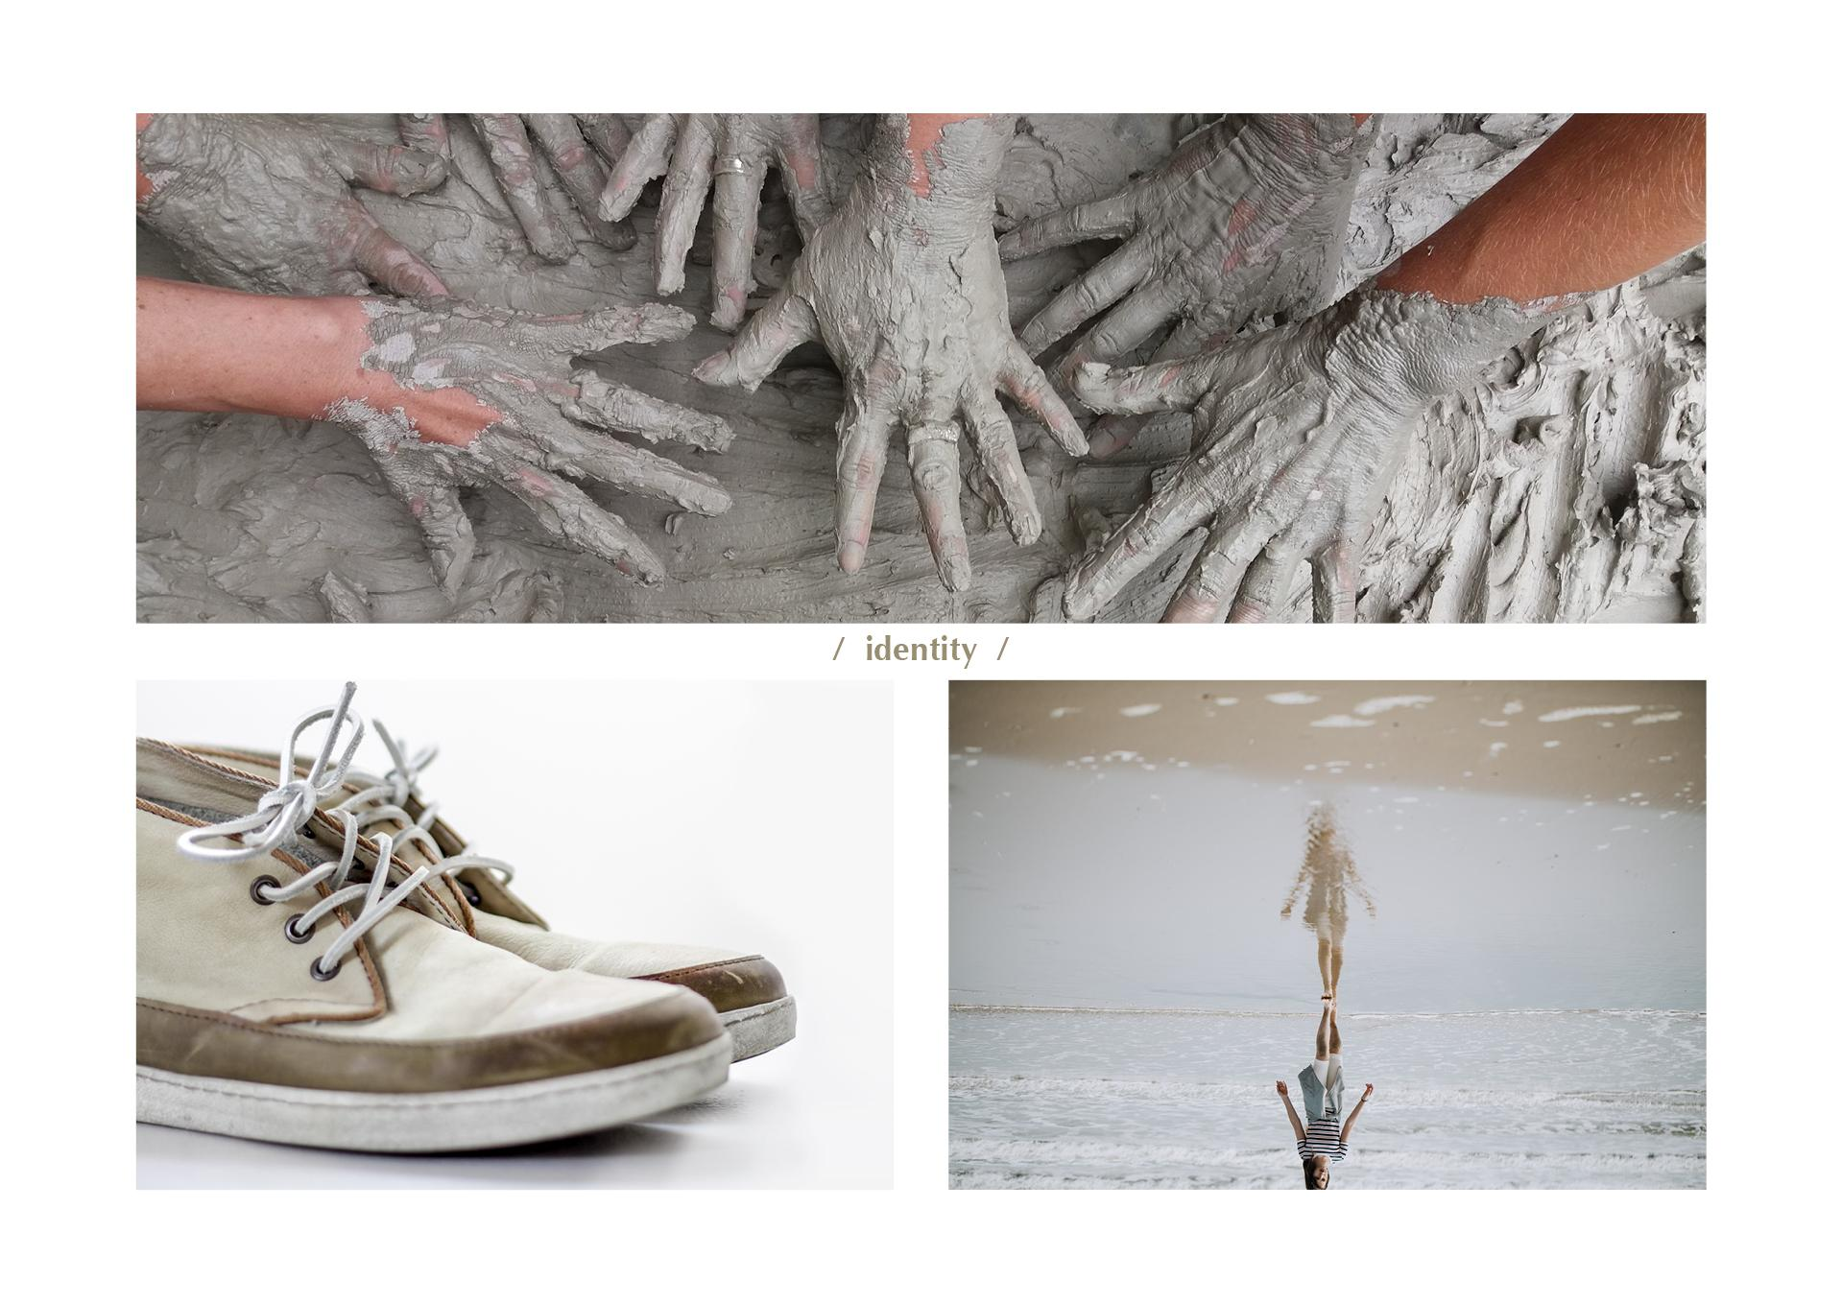
Logistics
Our Method
(30 minutes)
Preparation
Music
None
Room setting This is after ‘on the stages’ process and we will organize the chairs back to a circle
Centerpiece with the ‘workshop cards’ (Why am I here)
Tools & Facilities 4 Method cards- which we hand to the participants Facilitators booklet- to read the 4 stages of our Method
Participant’s booklet
Our Method (page 72-73)

Slide 9

Days before the workshop
2. Before Turning Point Program starts- 3 days & Logistics roles
Turning Point Program Pack:
Workshop Booklet
Notebook
L3 Exclusive set of cards
Goodies bag
Canvas Bag & 2 Badges Name Tag
L3 Certificate of Attendance & Expert Badge
Branding:
2 Turning Point Program Rollups
Turning Point Program Rollups

Slide 10
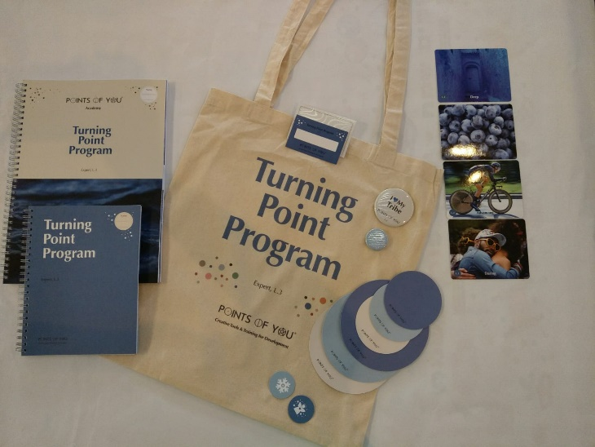
Days before the workshop
2. Before Turning Point Program starts- 3 days
Participant’s bag:
Canvas Bag & 2 Badges
Workshop Booklet
Notebook
L3 Exclusive set of cards
Name Tag
3 large dots (L3 colors)
3 small dots (L3 colors)
2 POY Angels

Slide 11
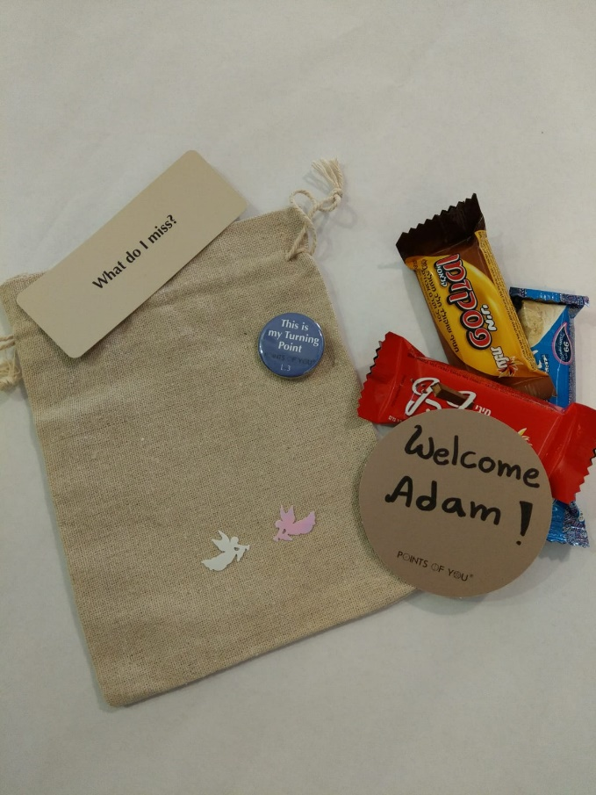
Days before the workshop
2. Before Turning Point Program starts- 3 days
Goodies bag:
Canvas Bag
1 Small Badge
1 small dots “Welcome (first name)” (punch a shaped hole on top to attach the bag)
2 Angels
3 different sweets
1 Question card
A personal greeting- If the HQ sent those (usually it is written on a large dot)
This bag will be a welcome gift we put on the participant's bed.

Slide 12
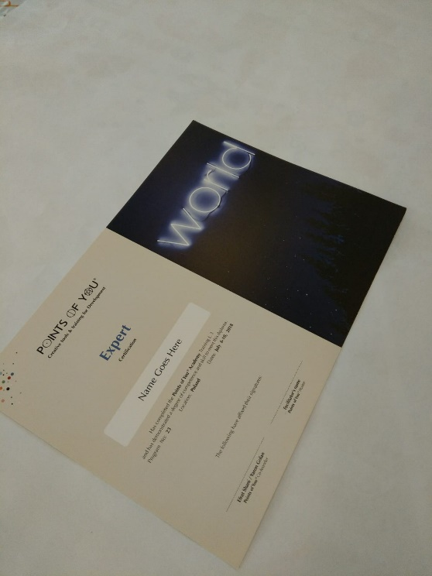
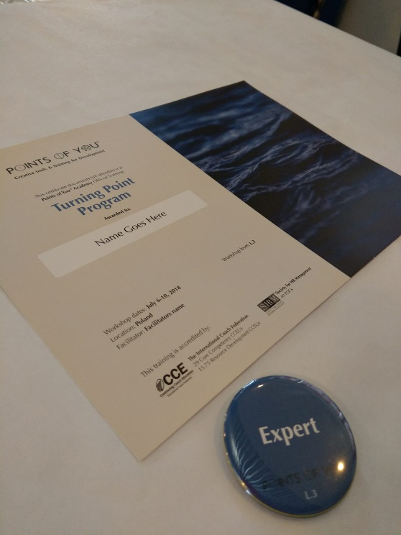
Days before the workshop
2. Before Turning Point Program starts- 3 days & Logistics roles
L3 Certificate of Attendance & an Expert Badge Make sure that all the Certificates arrived with full participant's names.
We will hand the Certificate & Badge at the Completion.
L3 Certificate of completion *Only after completing requirements. It will not be including in the boxes

Slide 13
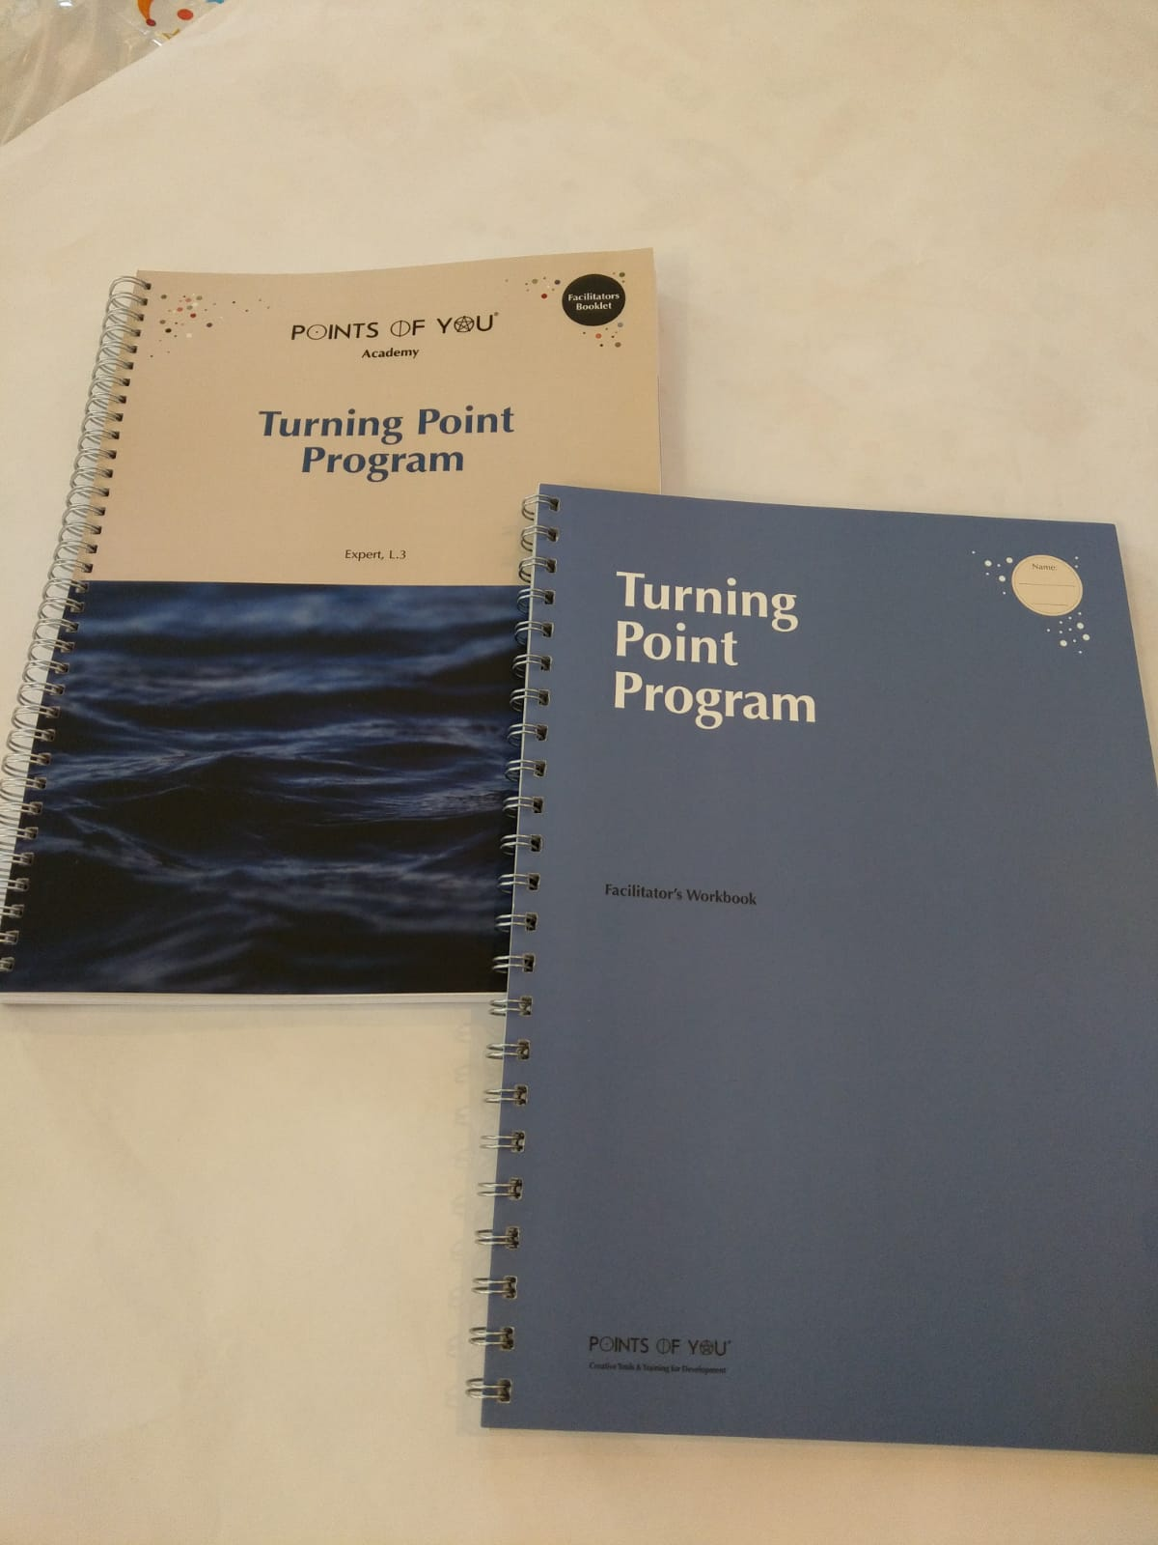
Days before the workshop
2. Before Turning Point Program starts- 3 days & Logistics roles
Facilitation Materials:
L.3 Facilitator’s booklet This is the booklet your get on Top View You will bring it with you to your TPP
Facilitator’s notebook This is a notebook that helps organizing information about our participants. You will receive it in the boxes.

Slide 14
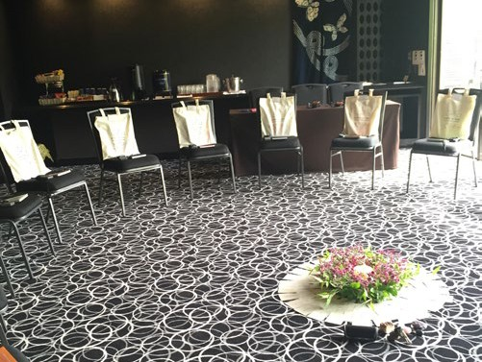
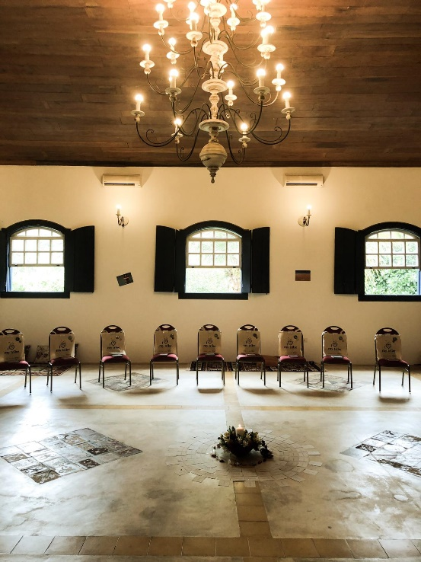
Days before the workshop
2. Before Turning Point Program starts- 3 days & Logistics roles
Room Setting:
A circle of chairs- symmetric and equal, all chairs are the same and visible.
In the Center- a spot for the Centerpiece.
On each chair- a Participant’s bag, visible name tag, a Notebook, 2 angels, ‘cut paper shape’.
Angels- in different and unexpected places in the room
Notes:
General arrangement
1. A circle of chairs- everyone are visible. The facilitator should be sitting at the ‘top’ of the circle and the helpers on both sides. Co-facilitators should sit next to each other. The chairs should be comfy and it is ideal if they are all of the same kind. You and your helpers should sit on the same chairs as everyone else (you are equal to all participants except for the fact that you will not be switching chairs throughout the workshop).
2. In the center - a spot for the centerpiece
3. On each chair: - Participant’s bag
Participant’s name tag attached, so he or she will know where they should sit.
A notebook, and on it place a cut paper shape (from the welcome dot) +2 angels.
4. Spread out angles in different spots around the room (around the centerpiece, at the entrance, on
furniture… Make it unexpected.)

Slide 15
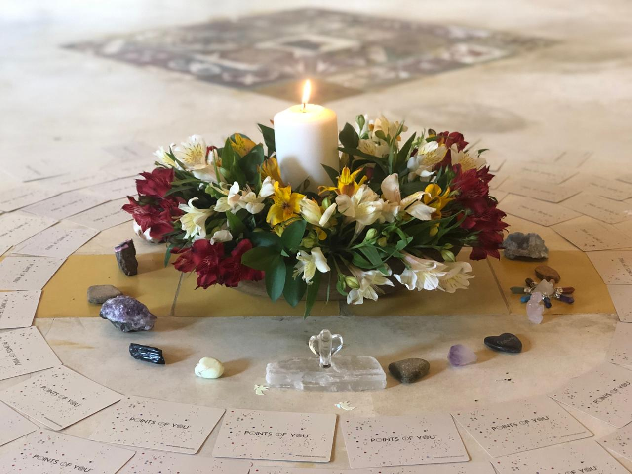
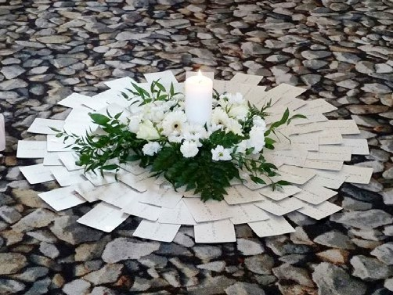
Days before the workshop
2. Before Turning Point Program starts- 3 days & Logistics roles
The Centerpiece:
A large bowl in the middle: inside: - A white candle - Flowers (real only!)- which reflects the location’s nature - Water for the flowers in the bowl
*Each morning the centerpiece must be refreshed
*Each morning we will relight the candle, before the participants enter the room
Organize the TCG & Refresh cards facing down around the centerpiece
Additional Items the Facilitator wants Once the room is ready– we are Smudging
Notes:
The Centerpiece:
1. A large bowl in the middle of the room containing:
- A white candle- large, odorless, make it neat and neutral - not artificial.
- Flowers (real only!)- which reflects the location we’re in (for example: Efrat used stones for the
centerpiece at the retreat in Israel desert rather than flowers.)
- Water for the flowers in the bowl.
*Each morning the centerpiece must be refreshed - change the flowers and water if needed.
*Each morning we will relight the candle, before the participants enter the room, and put it out at the
end of the day.
Organize the TCG & Refresh cards facing down around the centerpiece
The cards will be used for the first process of “why am I here?”
- The cards should be positive - take out of the deck: Death, Point of view and Fear.
- The facilitator may decide to take out of the deck additional cards intuitively.
The organization of the cards should be symmetrical, round, with no spaces and very aesthetic.
3. The facilitator may add additional items around the circle of cards. (Crystals etc.)
Smudging-Or Purifying the room- Light the Sage and clear the energy in the room. Walk around and spread the smoke in all areas. Efrat spreads the smoke over the cards, chairs, windows etc. * The Smudging should be done with intention - maybe even a prayer - tune yourself in before the participant’s arrival. Then, do smudging for the team, spread the smoke over the bodies of the helpers and facilitators.

Slide 16
Days before the workshop
2. Before Turning Point Program starts- 3 days & Logistics roles
Rooms & Roommates :
After reading all the participant’s profiles we divide the to roommates and assign them to the rooms
Food & coffee breaks
Make sure we get what was agreed from the hotel for each meal
Find the best spot to place the table for the coffee breaks Make sure it is refreshed and full towards each break
Water supply hot/cold – all day.
Special requests we have from participants.
“What do I leave behind” trail Make sure all team of facilitators & Helpers are familiar with the path.

Slide 17

Turning Point Program

Slide 18
Turning Point Program
3. During Turning Point Program – 5 days
Preparation
For each process during the Turning Point Program you will have 4 kind of preparations to make:
Music
Room setting Tools & Facilities
Participant’s booklet
Notes:
In the Facilitator's booklet- for each process there is logistics instructions.
Give an example of a process, like how to prepare logistically for Zooming In

Slide 19
Turning Point Program
3. During Turning Point Program – 5 days
Throughout the day during all 5 days:
we are keeping the room clean
Organized
Without trash
Removing cups & bottles
Organizing the chairs
A clean environment supports in cleansing the inside
Notes:
In the Facilitator's booklet- for each process there is logistics instructions.
Give an example of a process, like how to prepare logistically for Zooming In

Slide 20
A day after Turning Point Program
4. After Turning Point Program – 1 day
Logistic Closure:
Inventory count & Documenting (for Production DP.)
Packing
Documenting “I statements” and send to Production DP.
Notes:
Inventory count & Documenting (for Production DP.)
On the “mothership file”- the is a google sheet to write down the amounts of products.

Slide 21

Closure

